Slide 1


Slide 2
Today’s discussion aims …
—Introduction
—Objectives
—Login
—Screenshots
—UML Diagram, ER Diagram
—Description Of System
—Future Scope
— Advantage/Disadvantage
— Conclusion
—Refrence

Slide 3
Introduction
This project is aimed at developing a website for buying all category gaming. The E-Gaming Portal provides an easy interface that would let the users to get games.
. It provides the users more pleasure and gladdening his mind by buying these games such as Action ,Racing ,Adventurous games.
E-Gaming Portal is also providing best games in very cheap price that users can buy games in different categories

Slide 4
Objectives
The main objective of the E-Gaming Portal is for all gamers to get their favourite games in cheaper and best quality.
To build an application program to reduce the manual work for purchasing Games.
Main motive is “Pay and Play” best quality and very cheap games.

Slide 5
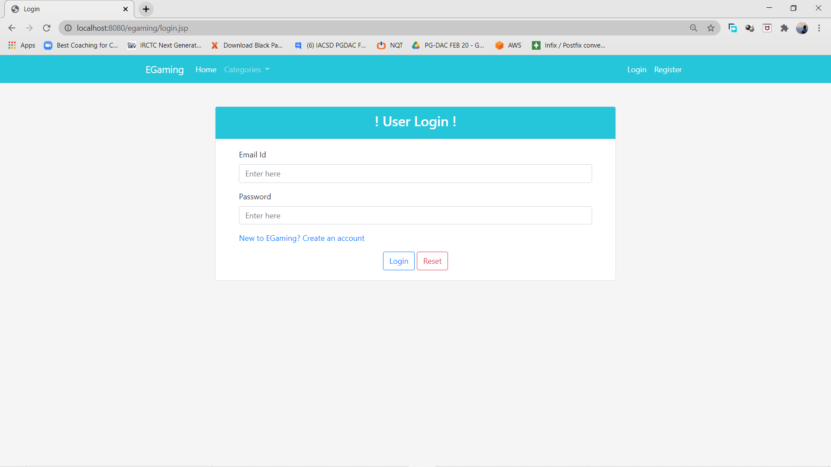

Slide 6
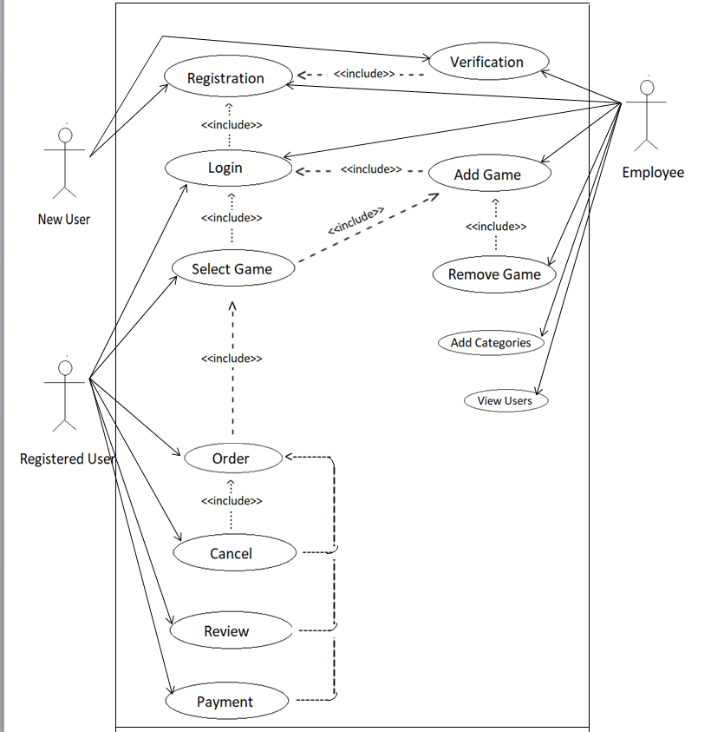
UML Diagram

Slide 7
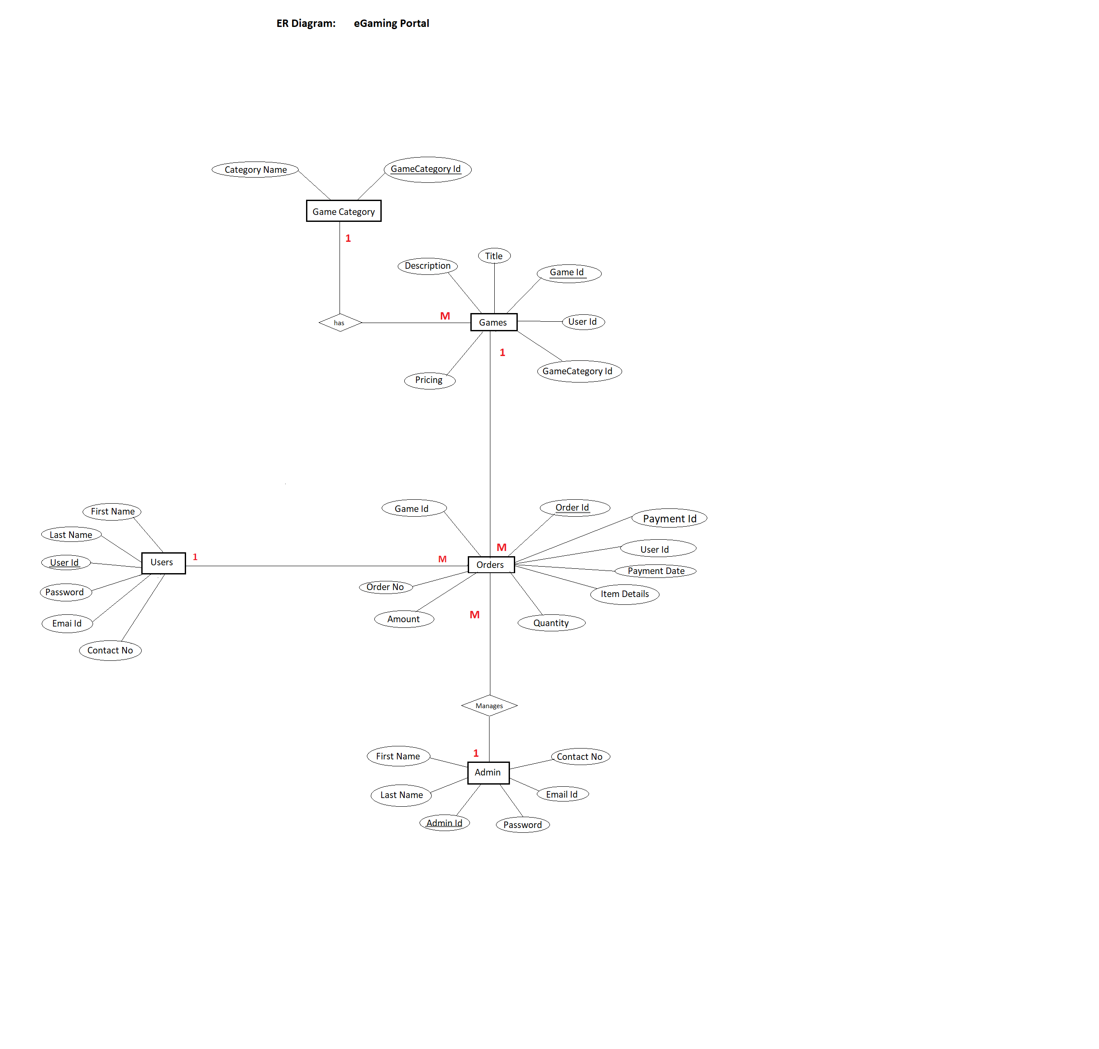
ER Diagram

Slide 8
Description of System
Product functionality:
E-gaming Portal provides the features for User and Gamers. It includes several functionalities describes as below
All Categories:
It provides many games with different category.
Game Management:
The User can view the list of Games, in wich user can add and purchase the game .

Slide 9
Future Scope
This project can be enhanced further by adding Many more Games in it.
The software is flexible enough to be modified and implemented as per future requirements.
We have tried our best to present this free and user–friendly website to the customers

Slide 10
Advantages / Disadvantages
Advantage :
The system allows the User to Buy Games.
User can search according to their wish of category of game.
Good Quality of games with Best price.
Disadvantage :
No as such any Disadvantage.

Slide 11
Conclusion
This system is a user friendly and GUI based website. It satisfies all the requirements of the proposed system to a great extent.
This system is developed in a way that it is easy to use and easy to maintain.
This system is mainly designed to reduce the cost, to increase the experience of the customer and to increase the operational efficiency.
The system is developed to help the customer to find the location of the package.

Slide 12
References
Books:
J2EE The Complete Reference.
JSP From Theory To Practice.
High Performance MySQL.
ONLINE REFERENCES:
www.salonist.in/
https://docs.oracle.com/javase/tutorial/

Slide 13
Thank You!!!

